Slide 1
Dow Jones Share Market Index evaluation
Presenter: Karun Dhingra
Time Series Analysis

Slide 2
Background
In predicting stock prices you collect data over some period of time - day, week, month, etc. But you cannot take advantage of data from a time period until the next increment of the time period. For example, assume you collect data daily. When Monday is over you have all of the data for that day. However you can invest on Monday, because you don't get the data until the end of the day. You can use the data from Monday to invest on Tuesday. In this research each record (row) is data for a month. Each record also has the percentage of return that stock has in the following week (percent_change_next_weeks_price).

Slide 3
Attribute Information
Predictors
open: the price of the stock at the beginning of the week
close: the price of the stock at the end of the week
volume: the number of shares of stock that traded hands in the week
Response Variable
percent_change_next_month_price: the percentage change in price of the stock in the following week

Slide 4
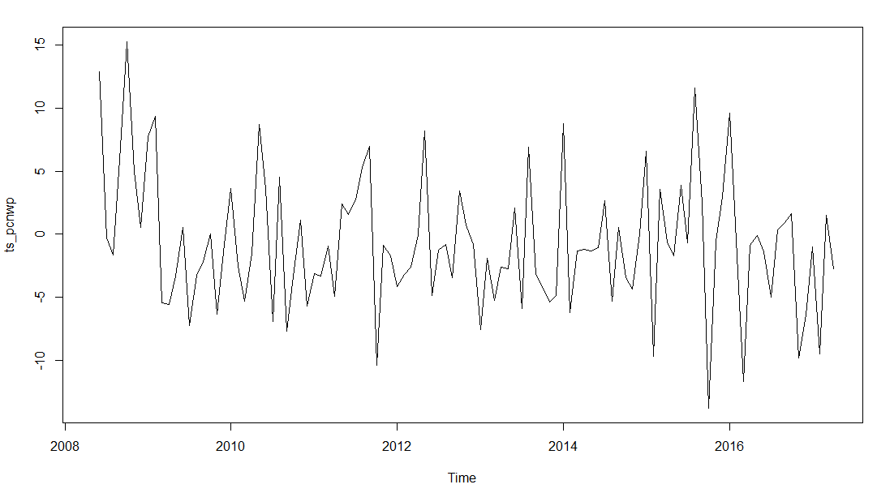
Time series for response Variable
Notes:
We can see from the time plot that this time series could probably be described using an additive model, since the random fluctuations in the data are roughly constant in size over time.

Slide 5
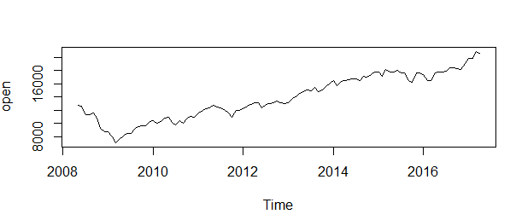
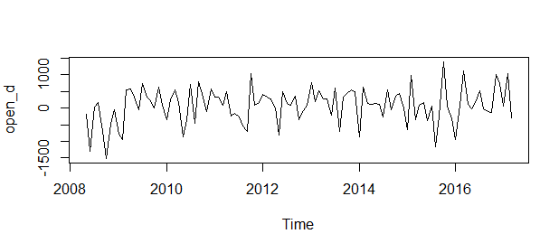
Predictors( Open)
Notes:
Linear trend is observed, hence ‘difference’ the time series until you obtain a stationary time series.

Slide 6
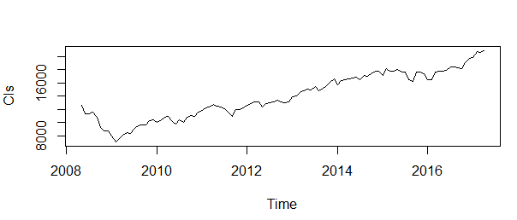
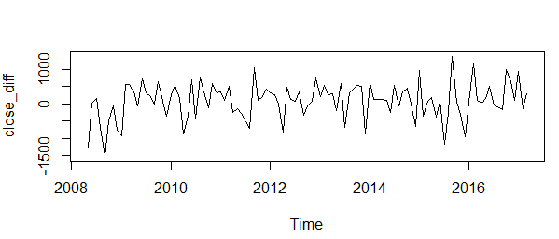
Predictor(Close)
Notes:
Linear trend is observed, hence ‘difference’ the time series until you obtain a stationary time series.

Slide 7
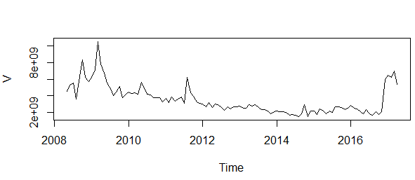
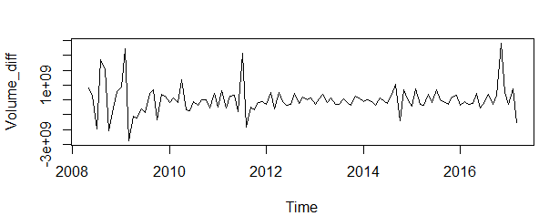
Predictor(Volume)
Notes:
Appear to be stationary in mean and variance, as the level of the series stays roughly constant over time, and the variance of the series appears roughly constant over time.

Slide 8
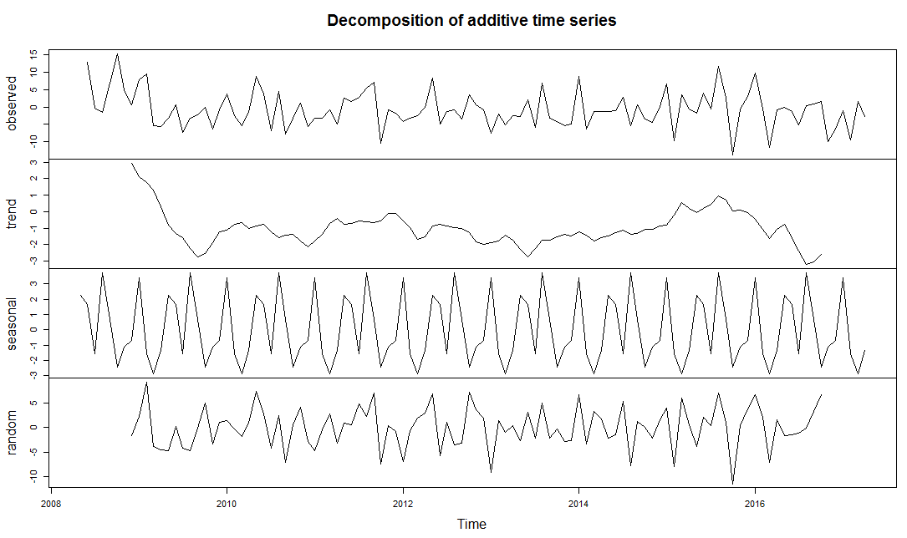
Decompose of response variable % change next month price
Notes:
We can see trend following a dip at the start of the 2008 may, and slowly follows sine wave.
Jan Feb Mar Apr May Jun Jul
3.3735338 -1.5532782 -2.9003245 -1.3460166 2.2340609 1.6280068 -1.5439576
Aug Sep Oct Nov Dec
3.718247 0.6745401 -2.4331369 -1.1417507 -0.7099245
August has been even more of a headache for investors more recently. Since 1987, the Dow Jones industrial average has posted average losses of 1.1% in August, making it the worst month for equities in the past 30 years, according to Jeff Hirsch, editor of the Stock Trader’s Almanac.

Slide 9
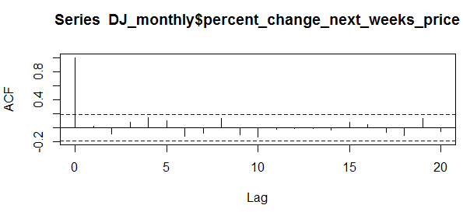
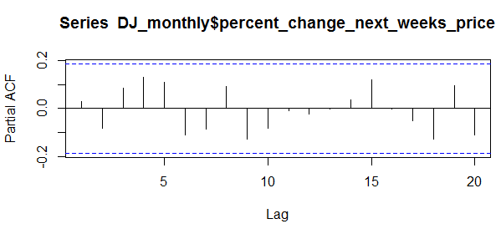
Acf/Pacf
Notes:
No such autocorrelation is seen in the acf , the pacf has positive peak at 2,3,4 but it is still under the significant level

Slide 10
ARIMA (Without Predictors)
As the lag goes to zero after lag 4 and pacf follows the same pattern we can have a model for the time series for the percent change in next week price as ARMA(4,0,0)
ARMA(0,0,3) - If we want to see the short term dependency of the monthly impact on the next one for the percent change
We can try different model or maybe go for HoltWinter Filtering as in this case we are not assuming the regressors to take part in prediction.
Notes:
An AR (autoregressive) model is usually used to model a time series which shows longer term dependencies between successive observations.
A MA (moving average) model is usually used to model a time series that shows short-term dependencies between successive observations

Slide 11
Coefficients & Goodness-of-fit
ARMA(4,0,0)
Coefficients:
ar1 ar2 ar3 ar4 intercept
0.0333 -0.0784 0.0847 0.1409 -0.7602
log likelihood = -326.89, aic = 665.78 BIC(m1) [ = 666.318
ARMA (0,0,3)
Coefficients:
ma1 ma2 ma3 intercept
0.0072 -0.0859 0.1191 -0.7806
log likelihood = -327.79, aic = 665.58 BIC(m1) = 661.948

Slide 12
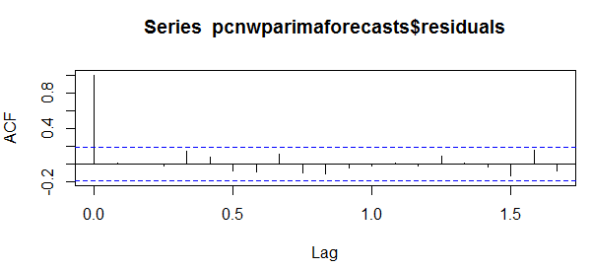
Forecast
> pcnwparimaforecasts
Point Forecast Lo 80 Hi 80 Lo 95 Hi 95
May 2017 -2.0068523 -8.641524 4.627819 -12.15371 8.140002
Jun 2017 -0.2208761 -6.855718 6.413966 -10.36799 9.926239
Jul 2017 -1.0841049 -7.743380 5.575170 -11.26859 9.100378
Aug 2017 -0.7806382 -7.486651 5.925374 -11.03660 9.475323
Sep 2017 -0.7806382 -7.486651 5.925374 -11.03660 9.475323
Notes:
shows that none of the sample autocorrelations for lags 1-20 exceed the significance bounds , we can check the Ljung –Box test for the p-value whether there is evidence for non-zero autocorrelations in the forecast errors or not.
time plot of the in-sample forecast errors shows that the variance of the forecast errors seems to be roughly constant over time

Slide 13
Impact of the open, close and Volume
Nested model for checking the effect of the predictors, like adding and removing volume or closing stats in the percent change next week price
Trying different lag to check for the model for say a.x(t – 1) for lag 1 or adding another lag to the regressor.
Different ARMA model for taking into account the Autoregressive components and the moving average components (We don’t have the difference component as the time series is stationary)

Slide 14
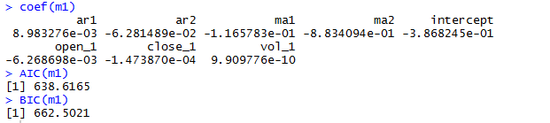
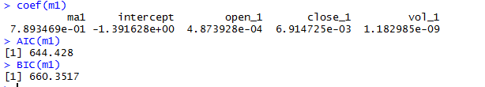
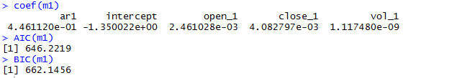
ARIMA c(2,0,2) /c(0,0,1)/c(1,0,0)
Notes:
Once the data are in their stationary form or this seems a reasonable approximation, then the AR, MA and ARMA models all approximate each other. In the finance case it is often true that the MA and AR coefficients are almost the same so unusually an AR(1) and MA(1) model will both fit the data well. Any approximation that arises by inversion of the MA or the AR component being negligible in a finite sample

Slide 15
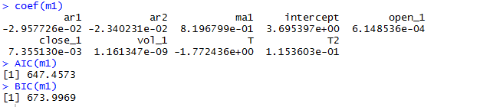
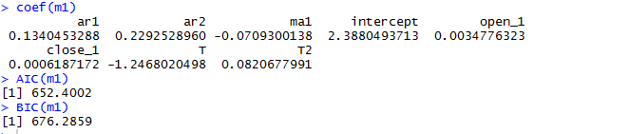
Comparison for ARMA (impact of Vol)
With Volume predictor:
Without putting in the Volume predictor:

Slide 16
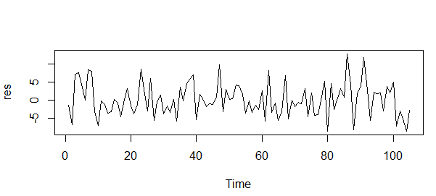
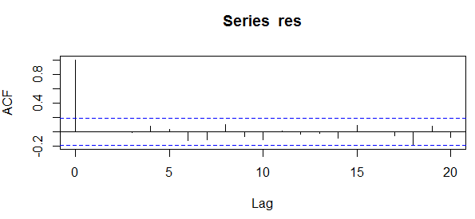
Residual and it’s ACF (2,0,2)

Slide 17
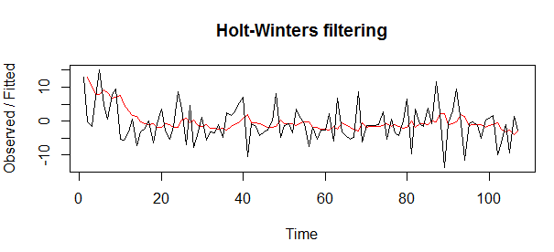
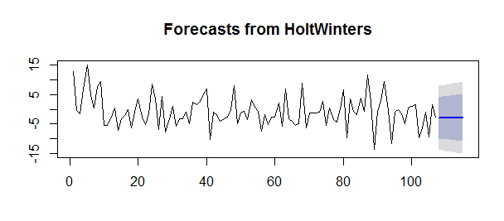
HoltWinter - Assumptions
Notes:
Exponential smoothing methods are useful for making forecasts, and make no assumptions about the correlations between successive values of the time series.

Slide 18
Bibliography
Relevant Papers:
Brown, M. S., Pelosi, M. & Dirska, H. (2013). Dynamic-radius Species-conserving Genetic Algorithm for the Financial Forecasting of Dow Jones Index Stocks. Machine Learning and Data Mining in Pattern Recognition, 7988, 27-41.
http://a-little-book-of-r-for-time-series.readthedocs.io/en/latest/src/timeseries.html

